Slide 1
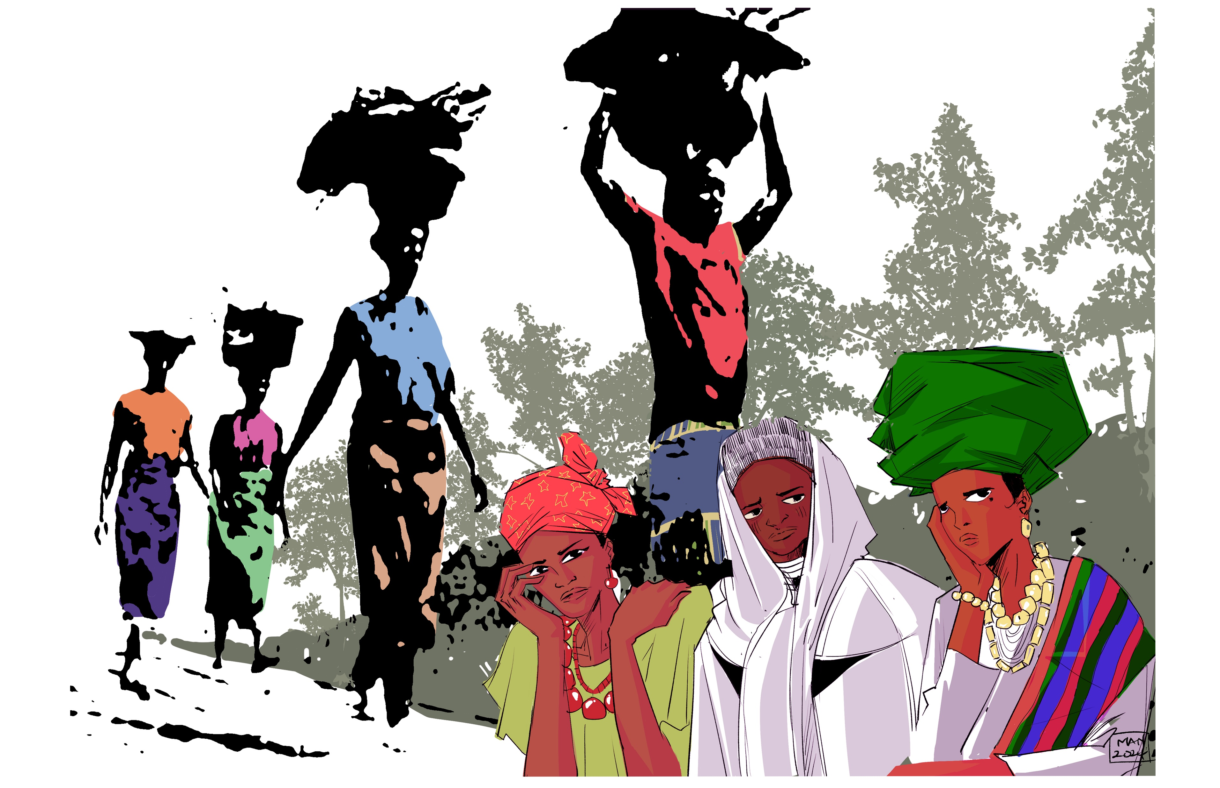


World Day of Prayer 2026 Worship Service
Prepared by the WDP Committee of Nigeria
Edited for use in Canada by the Women’s Inter-Church Council of Canada
“I Will Give You Rest: Come”
Matthew 11: 28-30

Slide 2
Leader 1: Welcome to the World Day of Prayer 2026 service written by Christian women in Nigeria.
Some of you may be wondering, what is World Day of Prayer? It is a global prayer movement of Informed Prayer and Prayerful Action. Christians from around the world coming together in spirit, uniting on a common day to pray for relevant issues affecting women and children. Each year, a committee of women from different countries writes the service materials.

Slide 3

Leader 1: In Canada, we are grateful for the Women’s Inter-Church Council of Canada, who distribute World Day of Prayer materials across all provinces and territories, and we stand in solidarity with each other through our prayers and actions.

Slide 4
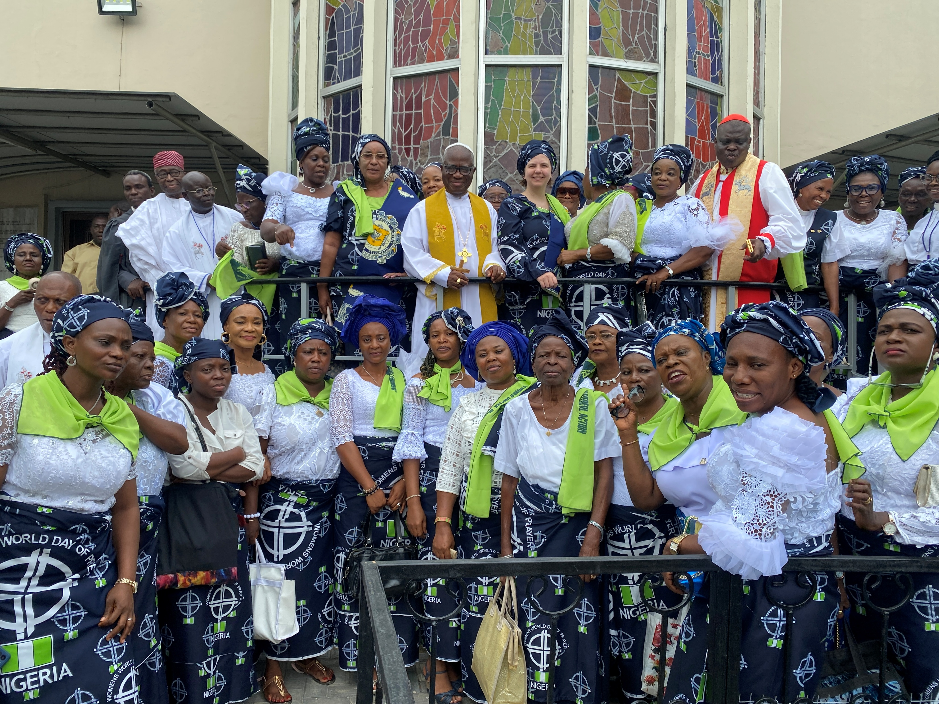
Leader 2: In 2027, we will be celebrating one hundred years of World Day of Prayer. Imagine over 1.5 million Christians speaking 90 different languages in 150 countries gathering in spirit; uniting to pray for relevant issues affecting women and children.
May God bless each of us as we gather with others from around the world in prayer and action.

Slide 5
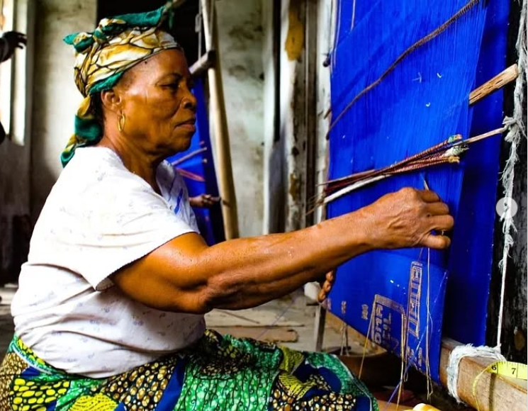
Leader 1: Imagine the vibrant textiles embodying the rich tapestry of Nigerian cultures, each pattern and colour telling a story of heritage and identity. They represent the resilience and creativity of Nigerian people, who weave beauty and meaning into everyday life.
Source: maderinnigeriatextile Instagram

Slide 6
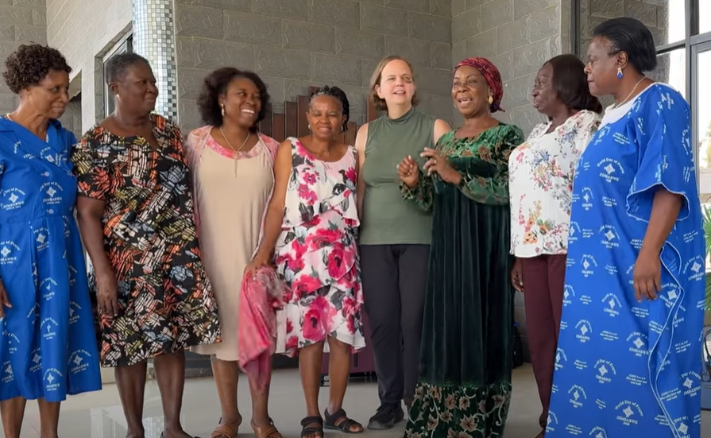
Leader 1: Like these interwoven threads, we are reminded of how our diverse stories come together in the fabric of our shared humanity and faith.
(Colourful fabric carried in by “Beatrice” - storyteller #1 - and placed on the table at the front of the sanctuary.)
Source: WDPIC

Slide 7
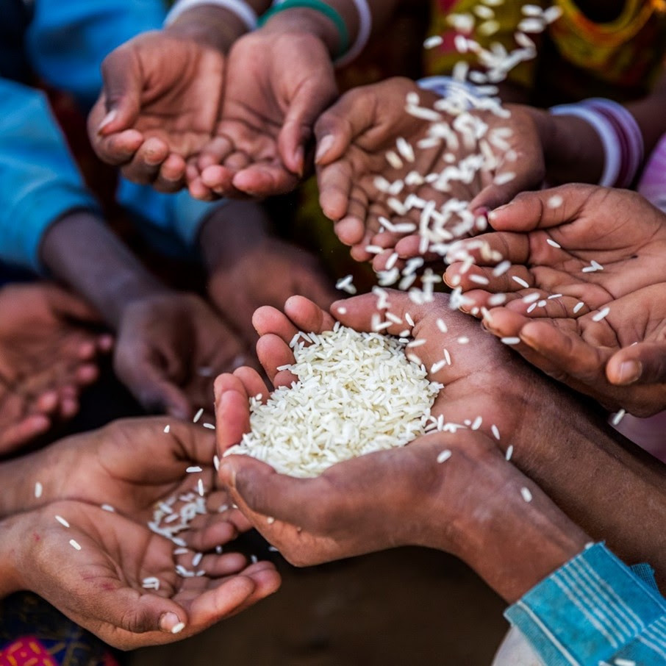
Leader 1: Consider the grains of rice that symbolize the interconnected burdens of poverty and despair, highlighting the relationship between economic hardship and mental health struggles.
(“Jato” – storyteller #2 carries in a small container of rice and gently spills it onto a plate on the table.)
Source: African Media Agency

Slide 8
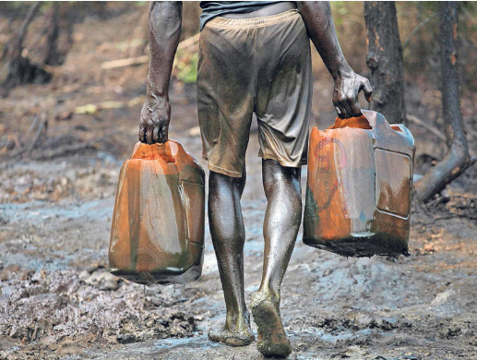
Leader 1: Picture olive oil in a glass jar representing Nigeria's complex history with crude oil, reflecting both potential for prosperity and the weight of global exploitation.
It represents the challenging balance between economic development and environmental stewardship, reminding us to pray for global equity and for innovative solutions that allow all nations to thrive sustainably.
(“Blessing” – storyteller #3 - carries in a jar of olive oil and places it on the front table.)
Source: Nigeria Info - FM

Slide 9
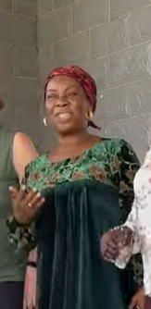
OPENING SONG OF PRAISE – Keleya (or song of your choice)
Leader 1: Let us sing together “Keleya” (Key-lee-ya), which was written for the World Day of Prayer 2026 service.
Source: WDPIC

Slide 10

Praise God, praise God, He is King,
Praise God, praise God, He is King,
Praise Jesus, He is King,
Jesus, you are good
KELEYA
Keleya, keleya nobueze, (“Key-lee-ya” “no-boo-ah-zay”)
keleya keleya nobueze,
kele Jisus nobueze, (“Jesus”)
Jisus I di nma. (the “n” is silent in “nma”)

Slide 11
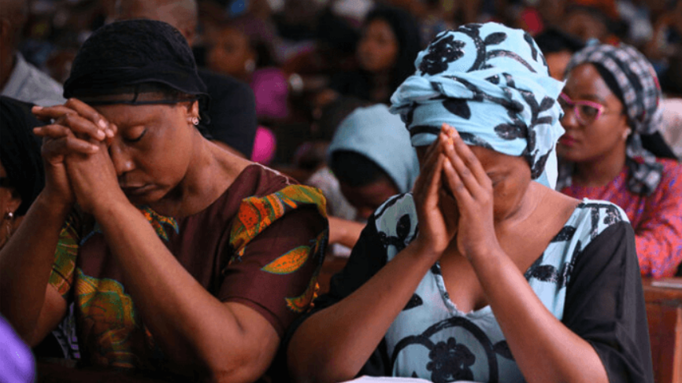
OPENING PRAYER
Leader 2: Let us pray:
God, our Burden Bearer, we come before you in praise and adoration! You are the Alpha and Omega, the beginning and the end. In You, we live and move and have our being.
Source: Businessday

Slide 12
Leader 2: We have gathered, trusting your promise that where two or three are gathered in your name, you are among us. God, we welcome and celebrate your presence in our midst.
We commit this worship into your hands, praying that you will come among us. Help us be open to the Spirit that you are releasing upon us and let your presence fill this place.
In the name of Jesus, we pray.
Amen.

Slide 13
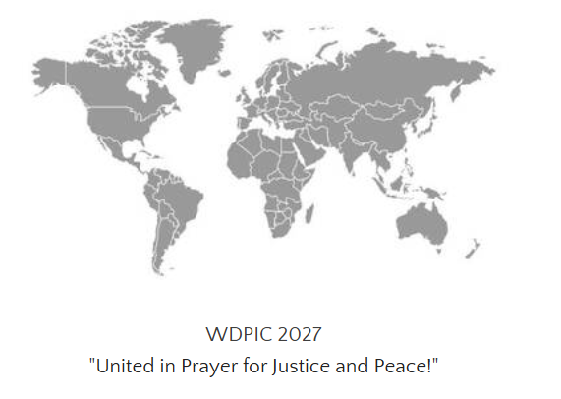
WORDS OF WELCOME
Leader 1: Welcome, dear friends, to this gathering of people from various communities around the globe. We come together on this day to lift our collective voices, united in prayer and action. In 2027, 150 countries will be celebrating 100 years of World Day of Prayer! Imagine!

Slide 14
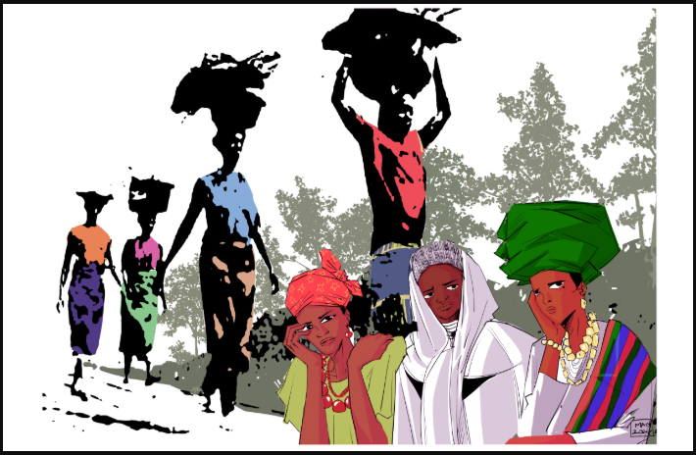
Leader 1: Our 2026 theme, I Will Give You Rest: Come, draws inspiration from Matthew 11:28. It serves as a heartfelt invitation from Jesus to all who are burdened and heavy-laden. And so, you are invited to come, just as you are. Bring all that weighs you down, and Jesus will give you rest.

Slide 15
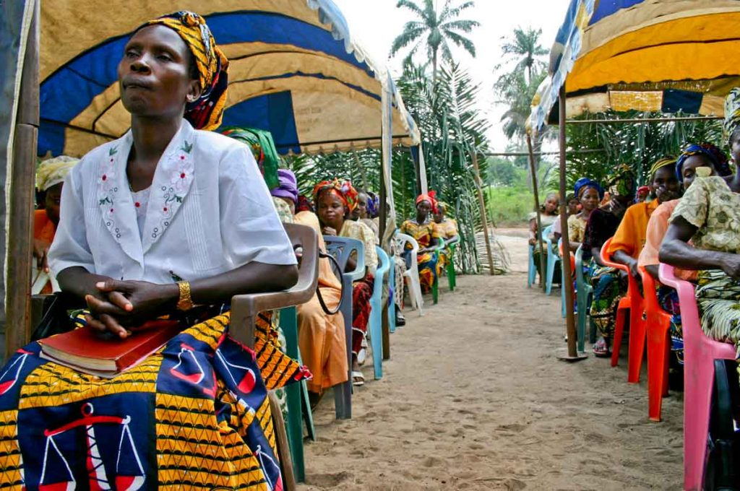
Leader 1: Christian women from Nigeria are calling out to you, wherever you are in the world, beckoning you to come and find rest for your souls. As we worship together, may we share each other's burdens and find renewed strength in our unity. May each of us find a sense of belonging here, as we are united in the embrace of Christ's love.
Source: The Christian Chronicle

Slide 16
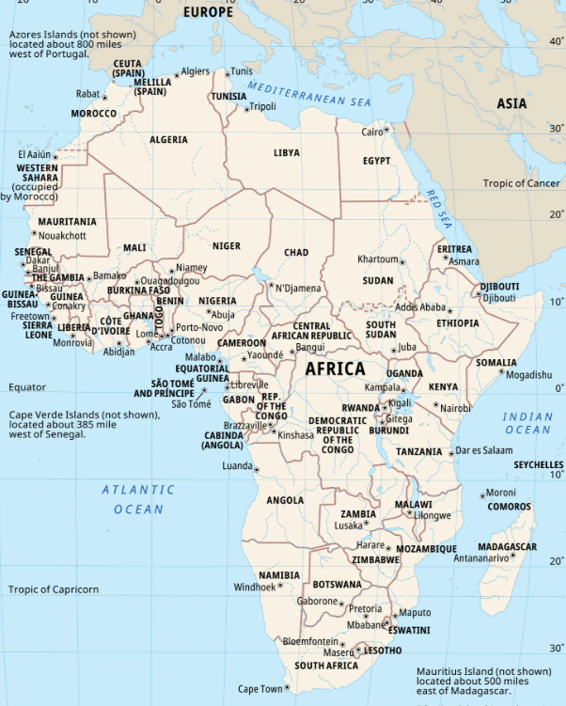
COUNTRY BACKGROUND (optional)
Leader 2: We are grateful for the Nigerian women who wrote the World Day of Prayer 2026 service. Let us now learn more about their country.
(Play 5a WDP2026 Nigeria country background video here)

Slide 17
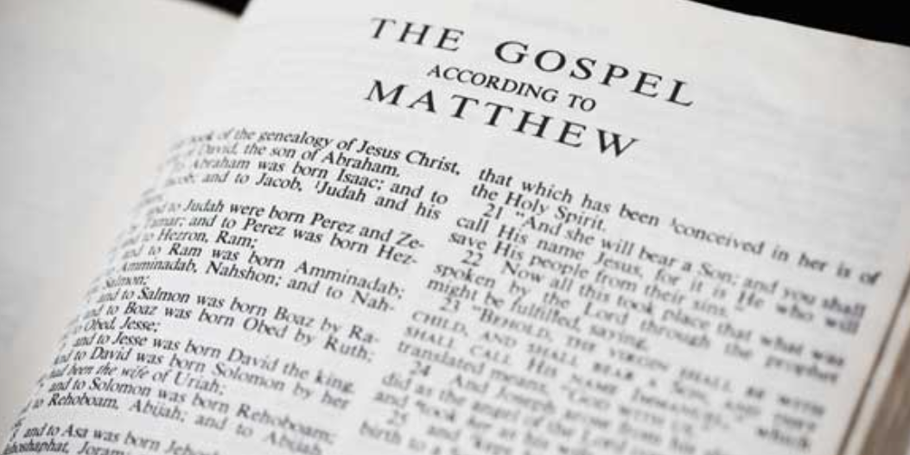
SCRIPTURE READING - Matthew 11: 28-30 (NRSV)
Scripture Reader: Let us now turn our hearts and minds to the words of Jesus found in the Gospel of Matthew. Matthew 11, verses 28 to 30. Let us hear these words as a gracious invitation from the very heart of God.

Slide 18
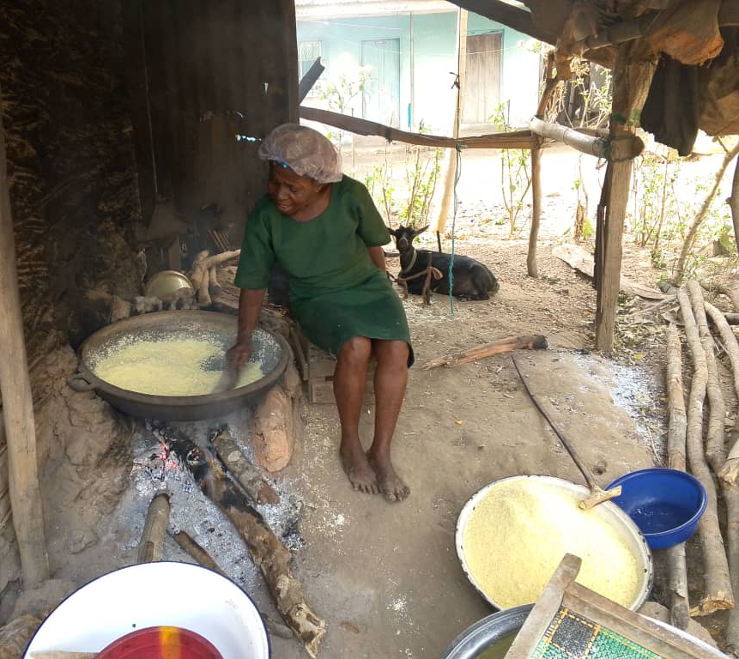
Scripture Reader: “Come to me, all you who are weary and are carrying heavy burdens, and I will give you rest. Take my yoke upon you, and learn from me, for I am gentle and humble in heart, and you will find rest for your souls. For my yoke is easy, and my burden is light.”

Slide 19
Scripture Reader: You are now invited to read responsively.
Scripture Reader: Come to Jesus, all you who are weary.
All: We come.
Scripture Reader: Come to Jesus, all you who are carrying heavy burdens.
All: We come.
Scripture Reader: God will give you rest.
All: God will give us rest.
Scripture Reader: Take on the yoke that Jesus offers. It is easy. It is light.
All: We receive this yoke.
Scripture Reader: Learn from the one who is gentle and humble in heart.
All: We are here to learn.
Scripture Reader: You will find rest for your souls.
All: Thanks be to God.

Slide 20
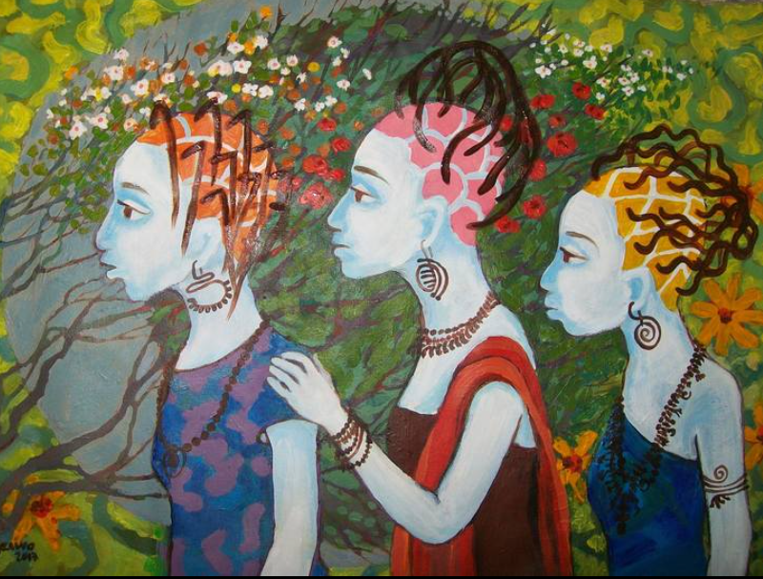
STORIES & PRAYERS
Leader 1: Dear sisters and brothers in Christ, we have now heard Jesus inviting us to come. To bring our burdens. And to find rest for our souls. And so, we open our hearts now, to listen to three stories of our Nigerian sisters. These testimonies reflect their experiences. And they mirror the struggles faced by many around the world.
Artwork by Juliet Enzenwa Pearch

Slide 21
Leader 1: We will now hear Beatrice’s story, the Burden of Systemic Oppression.

Slide 22
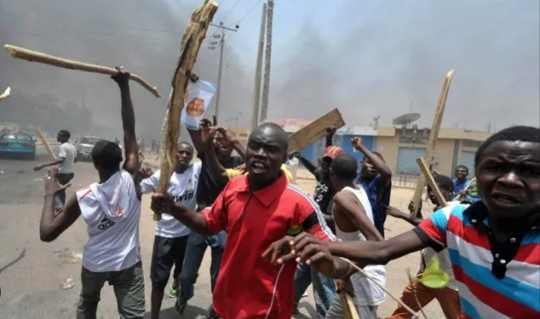
BEATRICE’S STORY: The Burden of Systemic Oppression
Woman 1: My name is Beatrice. I became a widow at the age of 28 when my husband was killed in a communal clash. The day I lost him, I lost more than just my partner. I lost my place in society. Suddenly, I was alone with three young children, facing a world that seemed to have turned its back on me.
Source: The Crest

Slide 23
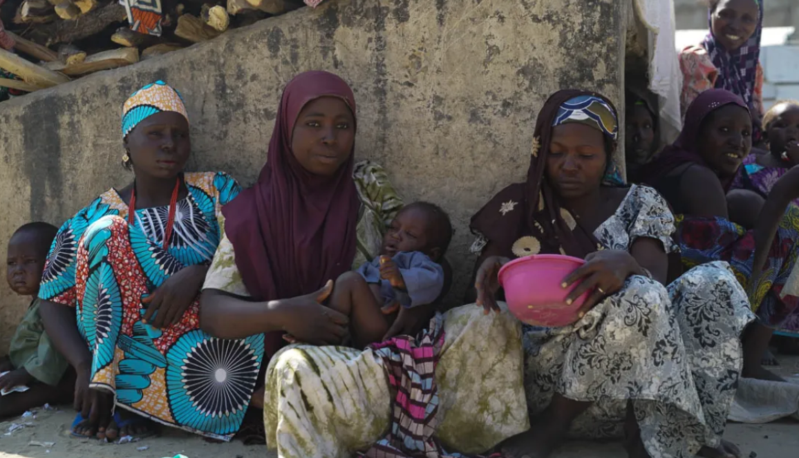
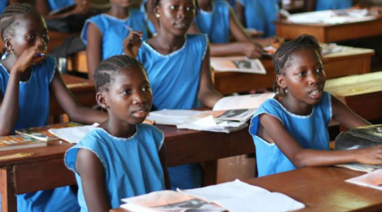
The struggles I've faced as a widow in Nigeria are overwhelming. Poverty hit us hard. I lost our main source of income and struggled to find work as a single mother. My in-laws, who I thought would support us, instead treated me with suspicion and tried to take away the little property my husband left behind. There were days I didn't know how I'd feed my children or pay their school fees.
Internally Displaced Persons Camp – Borno State.
Source: Al Jazeera
Picture source: ONE Campaign

Slide 24
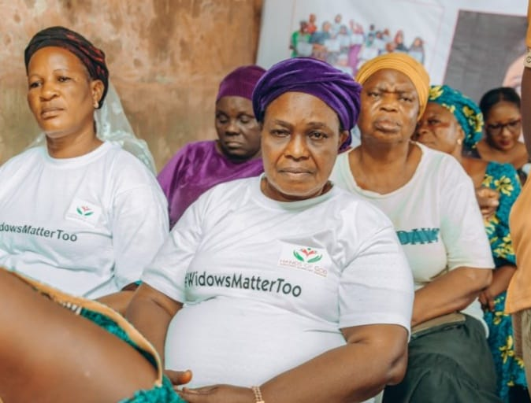
But in my darkest moments, I found strength in my faith and in the community of other widows. I remember attending a support program organized by my local church. They asked for 50 widows to attend, but hundreds showed up. That day, I realized I wasn't alone in my struggles.
Source: Hands of God Widows

Slide 25
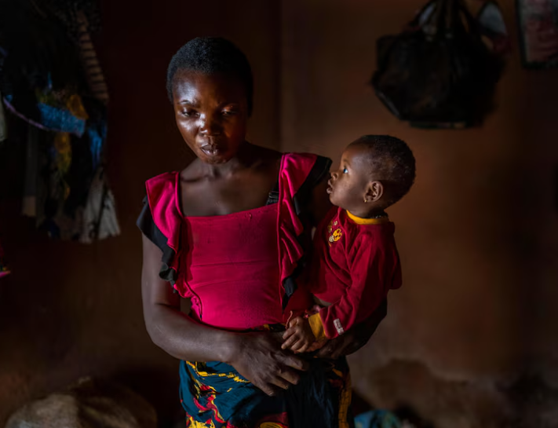
What has inspired me most is the resilience and faith of my fellow widows. Despite our hardships, many of us remain committed to Christ, finding solace in knowing Jesus as our Burden Bearer. I've seen young widows with small children serving tirelessly in the church, their faith unshaken by their circumstances.
Source: ABC News

Slide 26
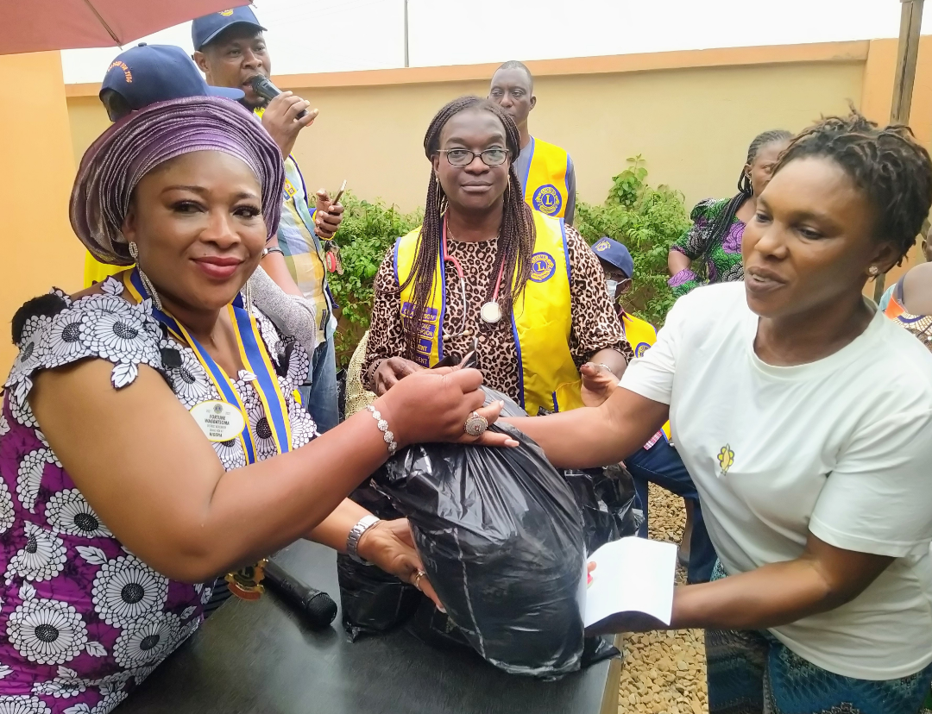
One widow in our community, after losing her husband, started a program to support other widows. She encouraged people to donate clothes, rice, and money to help us. Her actions inspired me to do the same. Now, I use what little resources I have to support other widows, and together, we're stronger.
Source: Ikorodu News Network

Slide 27
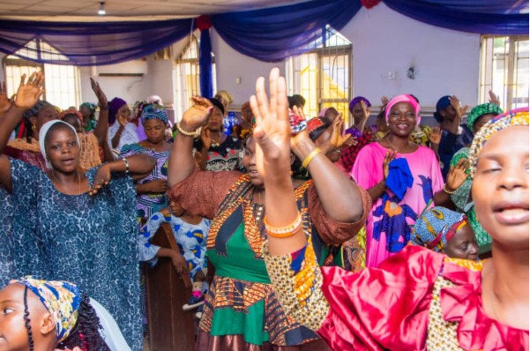
Through it all, we remain loyal to our families and the memory of our husbands. While widowers often remarry quickly, we focus on raising our children and keeping our families together. It's not an easy path, but with faith and community, we find the strength to carry on. Our burden is heavy, but we are learning to lay it at Jesus' feet, finding rest in His promise.

Slide 28
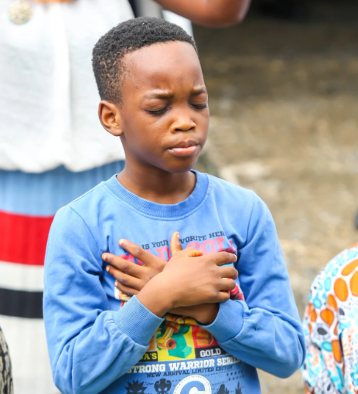
INTERCESSORY PRAYER
Leader 2: Let us pray:
God, you are the Great Burden Bearer. We come before you as your children, from all corners of the world. We lift up our voices, joining with Beatrice and all our siblings who carry the heavy loads of systemic oppression.
God of Compassion, we know that you see us. You see the discrimination faced by so many - women, widows, minorities, the poor. Some are overworked, breaking their backs in factories, fields, and homes, while others cannot find work to feed their families. Gracious God, intervene for us all!
Source: Green Pastures

Slide 29
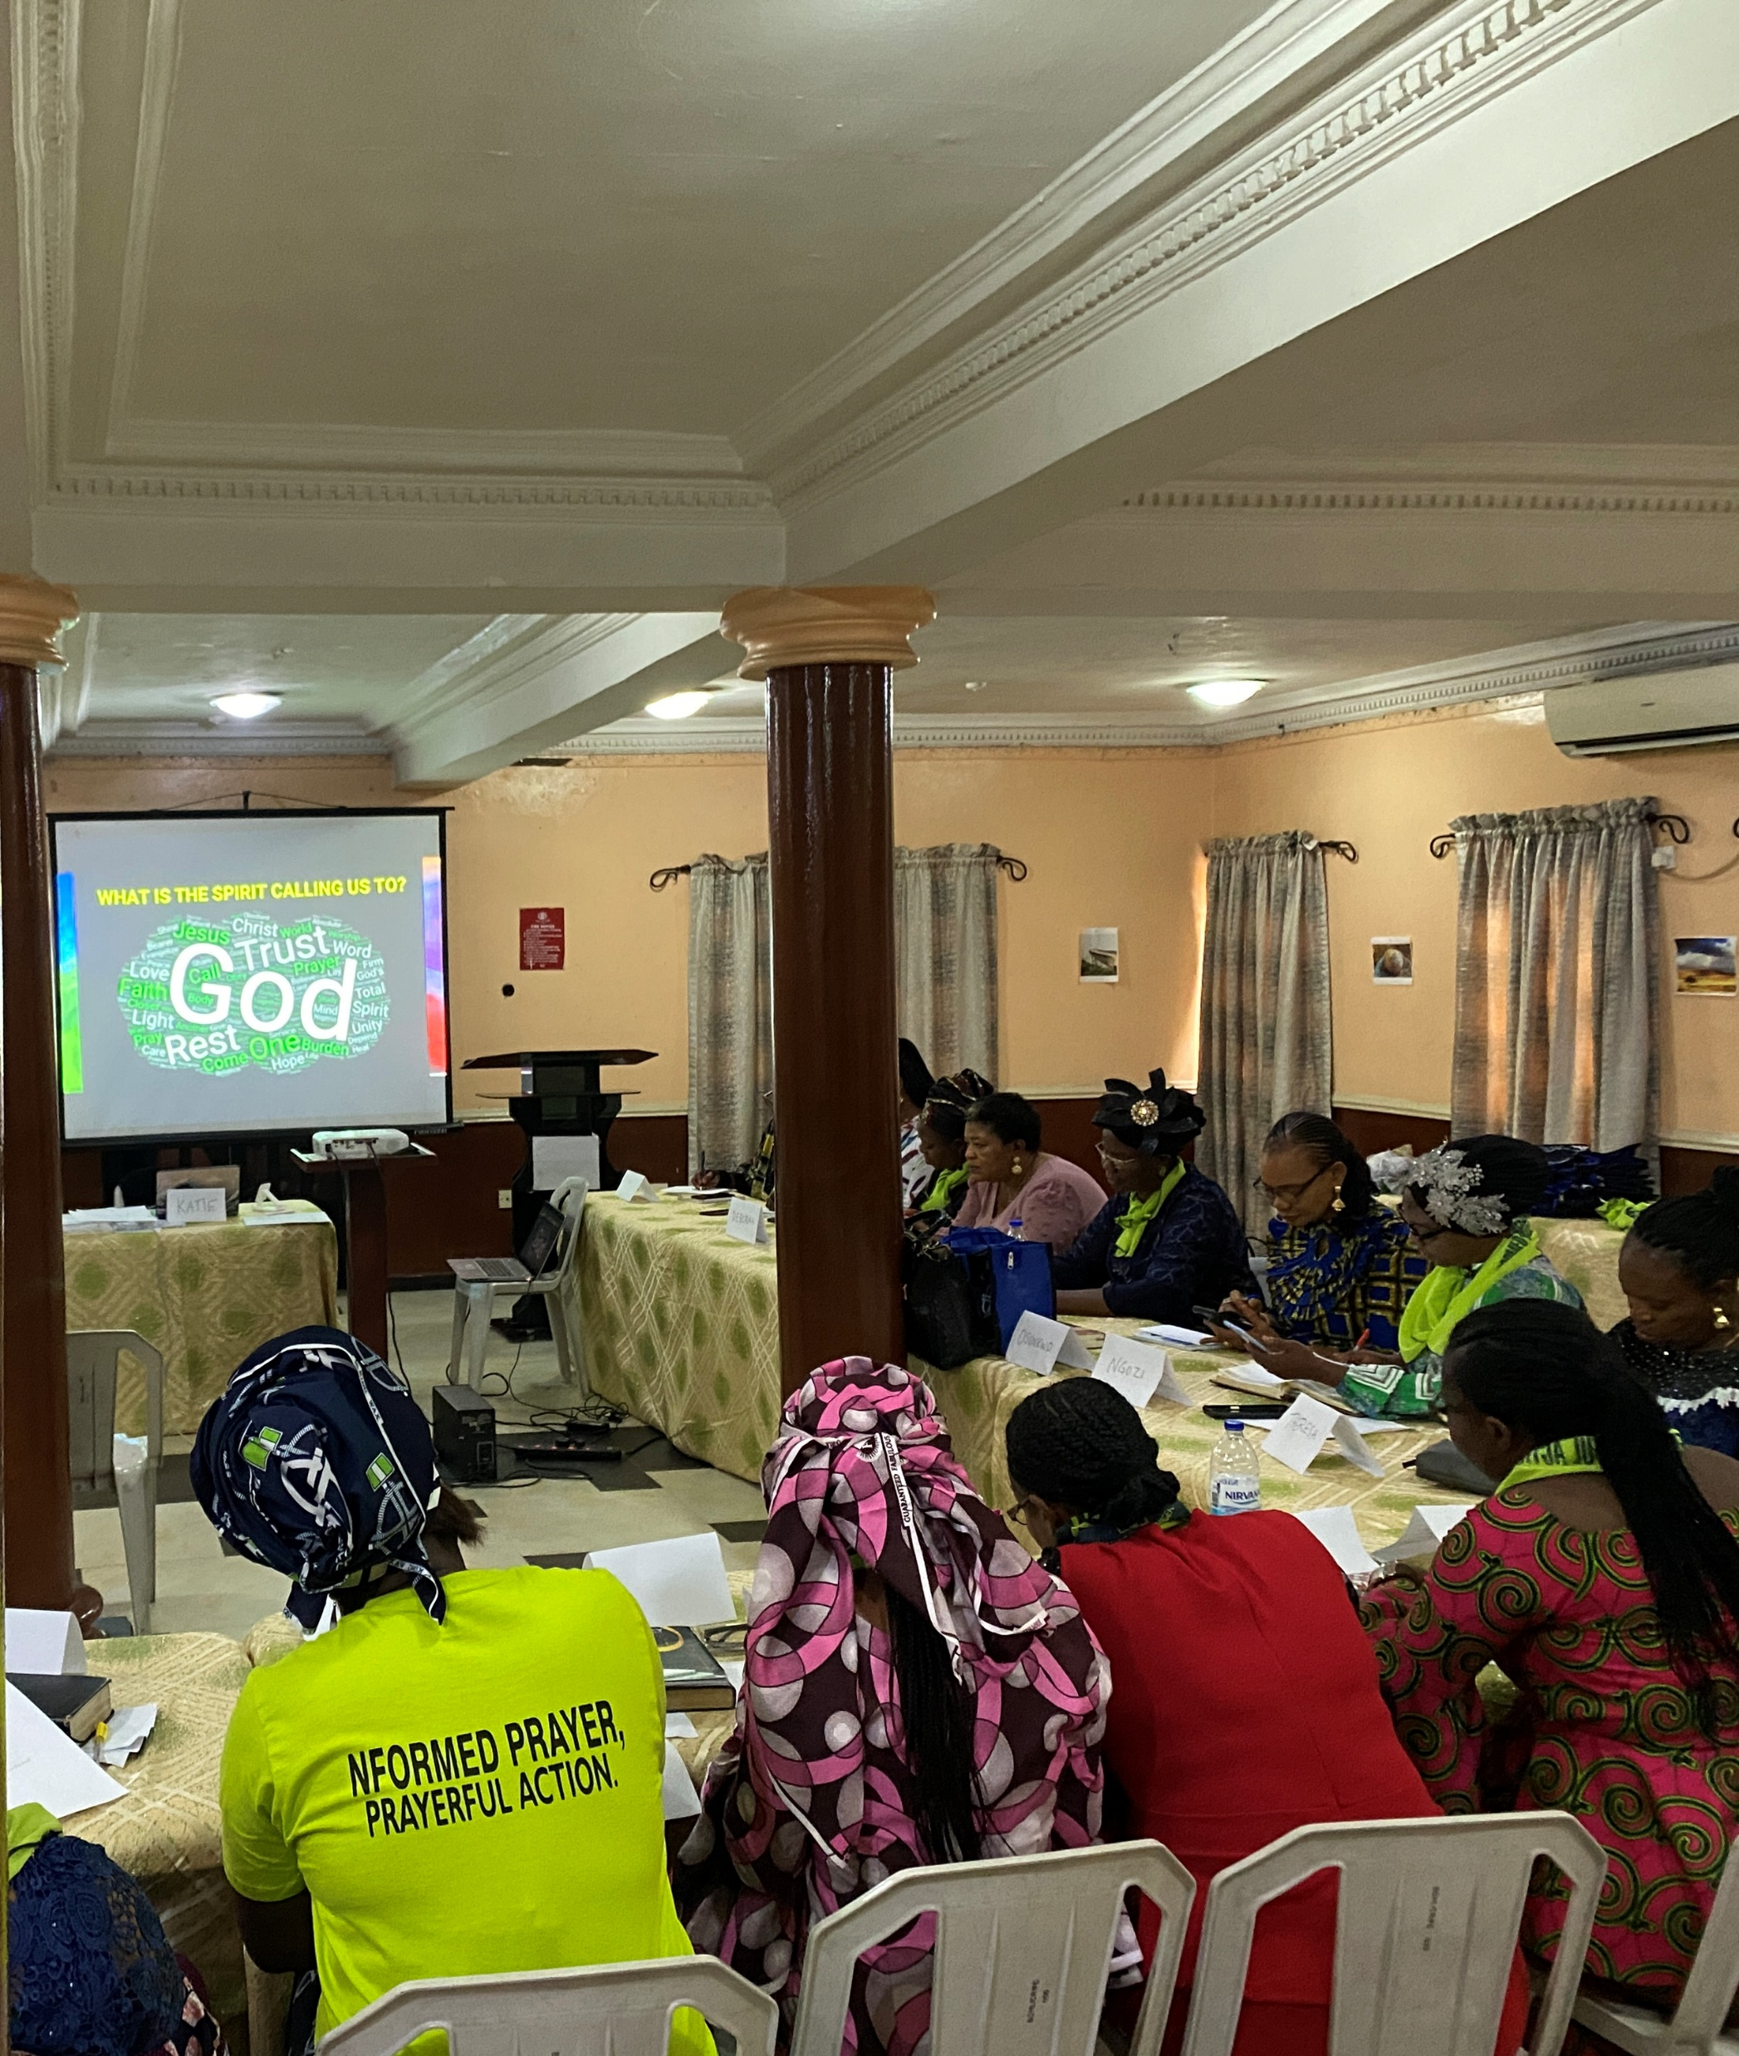
Leader 2: Thank you, Gracious God, for the resiliency and resourcefulness of all who remain faithful amidst difficult circumstances. Inspire us by their example and move us to build a better world.
Thank you, Loving God, for hearing our cries and bearing our burdens. We trust in your unfailing love and your mighty power to transform situations.
Amen.

Slide 30
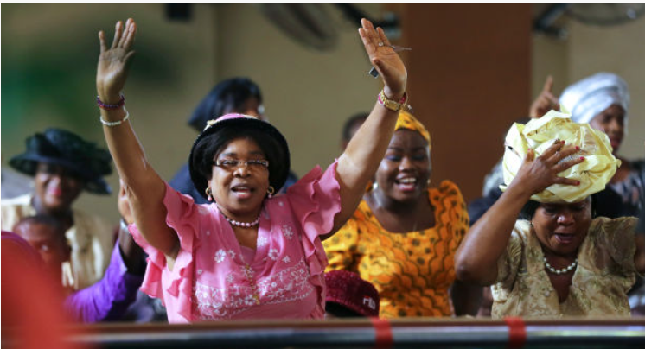
THEME SONG – Come Unto Me
Leader 2: Come Unto Me is a song that was composed especially for this World Day of Prayer service. Let us sing together and hear this call from the heart of God. Please stand as you are able.
Source: charismanews.com

Slide 31
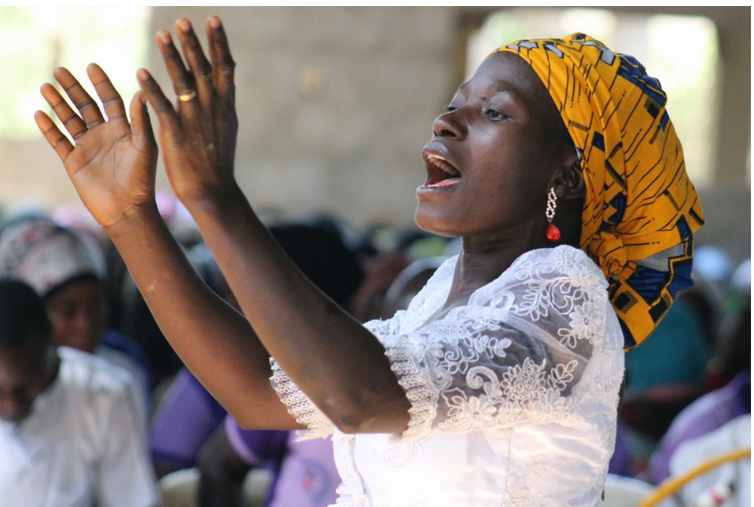
COME UNTO ME
Are you down and feeling lonely,
Are you weary and oppressed,
You don't have to be discouraged,
Jesus says, “Come unto me.”
Refrain:
Come, come unto me, (2x)
Come, you who are weary, and I will give you rest.
Come, come unto me, (2x)
Come, you who are burdened, and I will give you rest.
Tell your brother and your sister
That the Saviour is a friend.
and He offers you his shoulder,
lean on him and you'll find rest.
Source: UM News

Slide 32
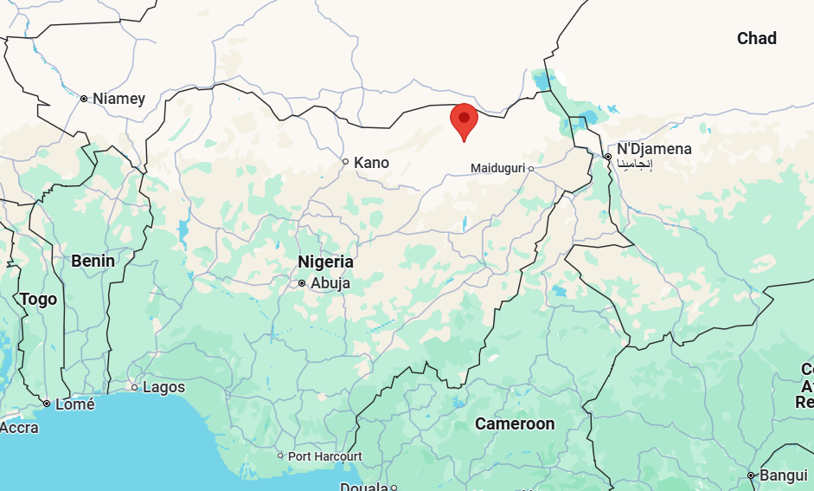
Leader 2: We will now hear Jato’s story, the Burden of Religious Persecution.
JATO’S STORY: The Burden of Religious Persecution
Woman 2: My name is Jato, and I am a Christian mother living in northern Nigeria. Every day when I send my 14-year-old daughter, Amina, to school, my heart tightens with worry. You see, Amina is the same age as Leah Sharibu when she was taken from her school in Dapchi, just a few hours from here.
Dapchi
Source: Google Maps

Slide 33
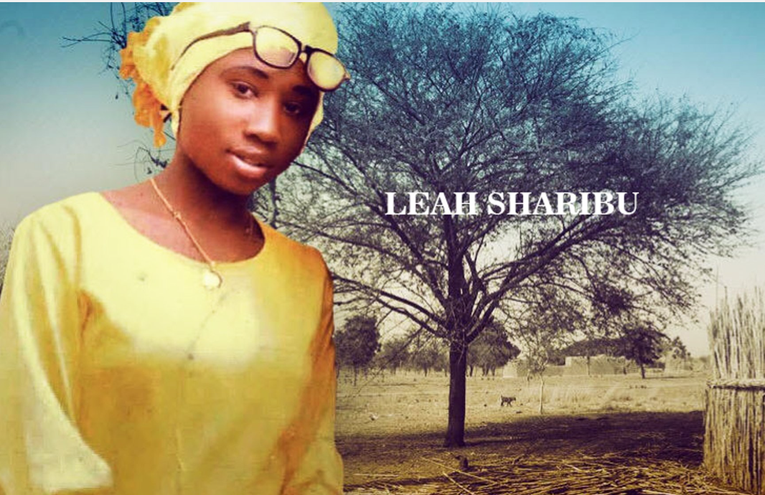
Leah's story haunts me. A young girl, steadfast in her faith, refusing to deny Christ even in the face of captivity. It's been eight years since Boko Haram took her, and still, she remains their prisoner. Every time I look at Amina, I can't help but think, "What if it had been her?"
Source: Africa Related

Slide 34
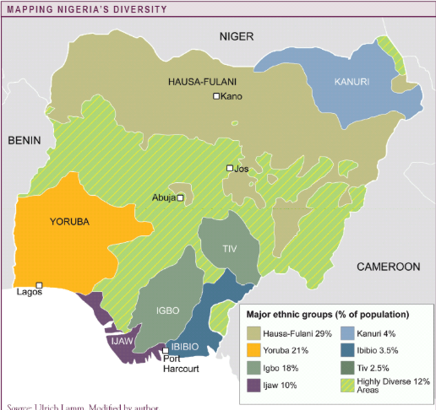
Living under the shadow of religious persecution is not easy. There are areas where Christians are killed simply for their faith. But by God's grace, we continue to live alongside our Muslim neighbours. It's not the same everywhere - in Yorubaland in the southwest, Christians and Muslims live together like family. And I know that in some parts of the world, Christians are the ones persecuting other religious groups because of their faith.

Slide 35
I often wonder, what does my faith call me to do in the face of religious persecution? Jesus teaches us to love our enemies, to pray for those who persecute us. It's not easy, believe me. Some days, when I hear of another attack, another kidnapping, I feel anger rising in my heart. But then I remember - being a Christian means being Christ-like.

Slide 36
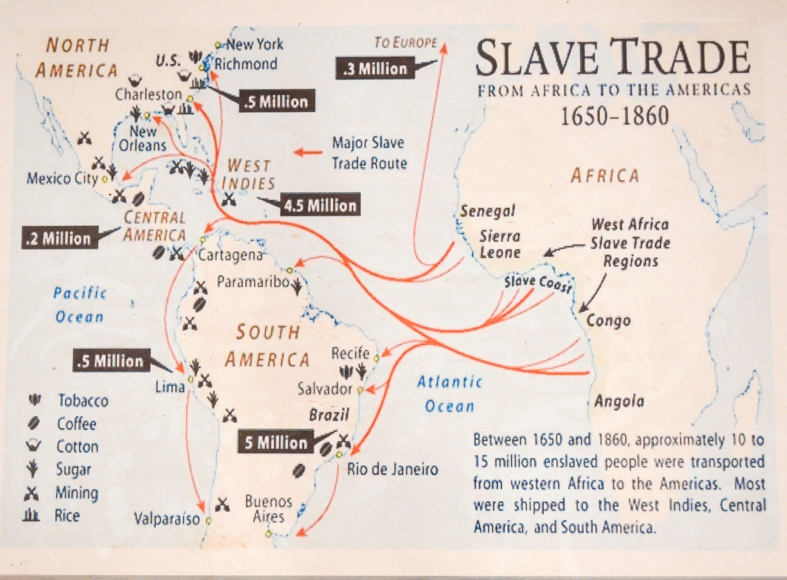
These conflicts didn't start yesterday. Even in Jesus' time, there were clashes among different groups. But Jesus showed us a different way. He calls us to show love, even to those who seem to have no regard for life. At first, this seems like a heavy yoke to bear, but Jesus promises that His yoke is easy, and His burden is light.
How do we find that lightness? It's only through God's grace. We carry the yoke of loving our neighbours - even when those neighbours wish us harm. It's not easy, but God's grace sees us through every challenge.

Slide 37
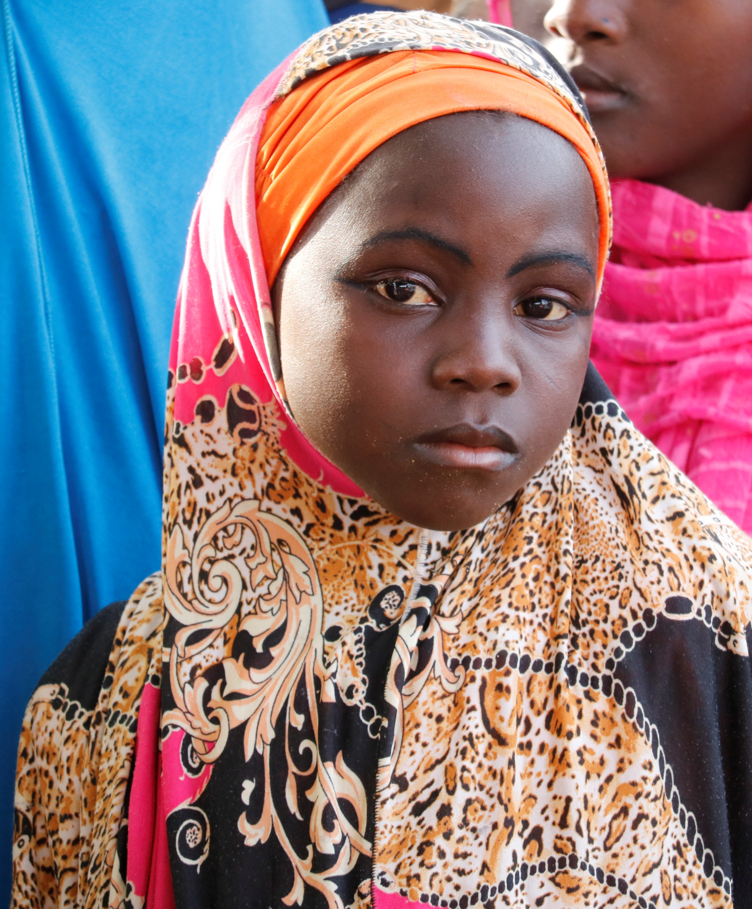
When I pray with Amina each morning before she goes to school, I remind her of Jesus' words: "In this world you will have trouble. But take heart! I have overcome the world." Our strength doesn't come from an expectation of an easy life.
Instead, it's rooted in the knowledge that Christ walks with us through every hardship. In the face of persecution, we don't simply await rescue; we actively live out our faith, knowing that each act of love and forgiveness is a testament to Christ's enduring power in our lives.

Slide 38
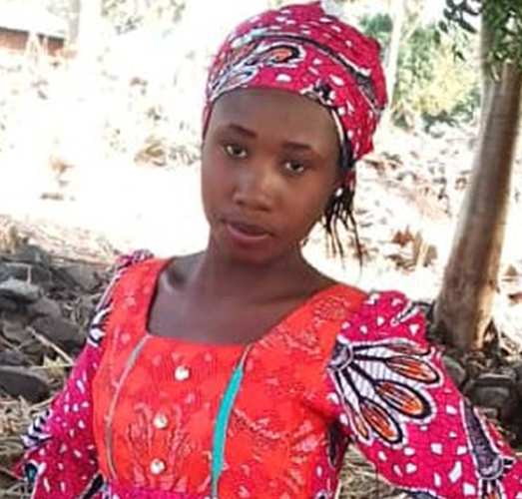
Leah's story reminds us of the cost of this faith. But it also shows us its power. In Damaturu, a small Christian community still gathers to pray for Leah's return. Their hope, their persistent faith, inspires me to keep believing, to keep loving, to keep living alongside all my neighbours - Muslim and Christian alike.
As I watch Amina leave for school each day, I pray not only for her safety but also for her heart. I pray that she, like Leah, will have the strength to stand firm in her faith. But I also pray that she will have the love to see the image of God in everyone she meets, regardless of their faith.
This is how we find rest in God - not by harbouring hatred or intolerance, but by letting Christ’s love flow through us, even in the face of persecution. It's a daily choice, a daily surrender. But in making this choice, we find that our burdens truly do become light, and in God, we find our rest.
Source: ACI Africa

Slide 39
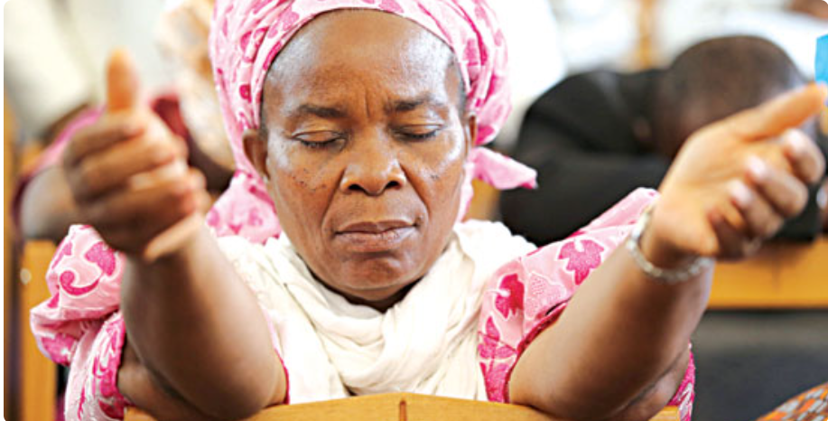
INTERCESSORY PRAYER
Leader 1: Let us pray:
God of the persecuted and protector of the faithful, we come before you with heavy hearts from Leah's story and the fears of mothers like Jato who send their children to school each day under the shadow of potential violence.
Source: The Guardian

Slide 40
Leader 1: Lord Jesus, you faced persecution and stood firm in your faith. We lift up Leah Sharibu and all who suffer for their beliefs. Grant them strength and comfort in their darkest hours, inspiring us to stand strong in the face of adversity.

Slide 41
Leader 1: Holy Spirit, we cry out for those displaced by violence, forced to flee their homes and become refugees in unfamiliar lands. Shelter all who are displaced under your wings, providing for their needs and guiding them toward safety and new beginnings.
Amen.

Slide 42
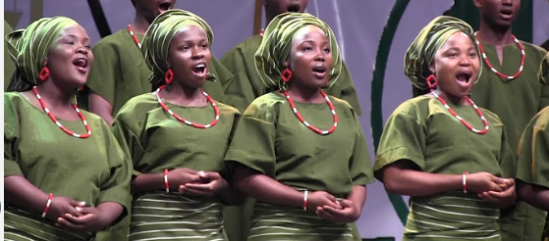
Leader 1: Let us sing together the refrain of the World Day of Prayer 2026 theme song “Come Unto Me.”
Please remain seated while you sing.
Come, come unto me, (2x)
Come, you who are weary, and I will give you rest.
Come, come unto me, (2x)
Come, you who are burdened, and I will give you rest.
Source: YouTube – Nigerian Choral Music

Slide 43
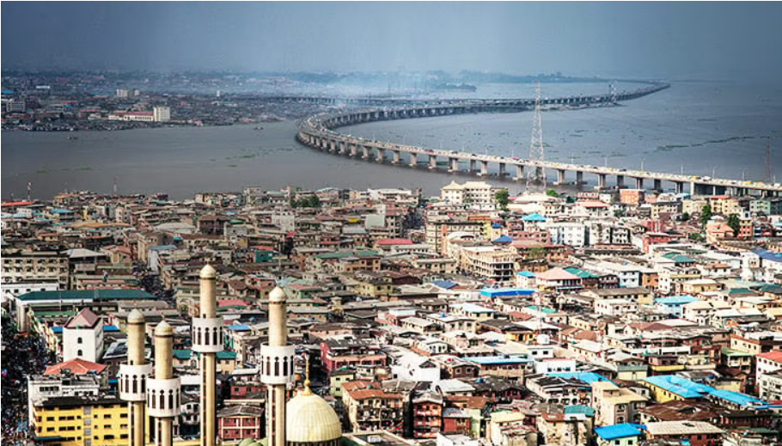
Leader 1: We will now hear Blessing’s story, the Burdens of Poverty and Despair.
BLESSING’S STORY: The Burdens of Poverty and Despair
Woman #3: My name is Blessing, and I've lived in Lagos all my life. I've seen Nigeria change over the years, but not in the way we all hoped. We dreamed of progress, of a better life for our children, but instead, we have watched our nation slide deeper into poverty and despair.

Slide 44
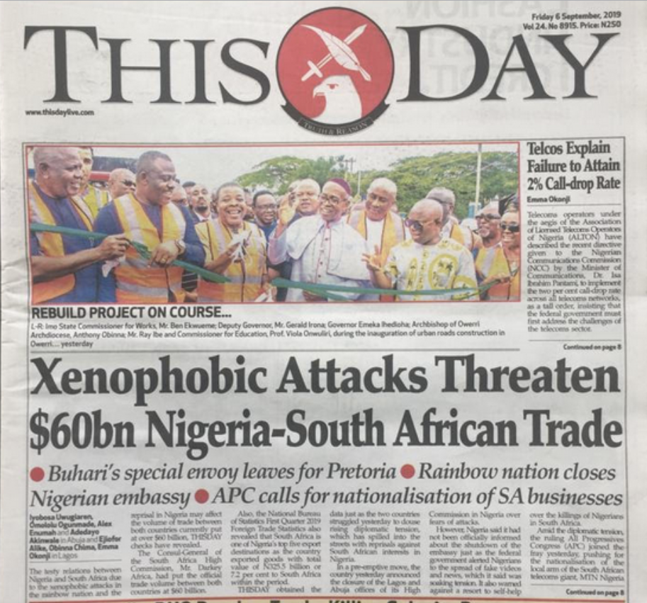
Every day, I see the toll this takes on our minds, our spirits. It’s like we are all trapped in a cycle of disappointment. We've been let down so many times that even when good things come our way, we are afraid to believe in them. That's Nigeria now – we've stopped believing that things can get better.
The government seems focused on itself, not on us. Salaries for most people aren't enough to live on, while a select few earn fortunes. A bag of rice – a staple food – is now a luxury for many families. Our young people, bright and full of potential, can't find work. Some fall into despair. And too many are committing suicide. Others turn to crime – kidnapping, banditry, or prostitution – out of desperation.

Slide 45
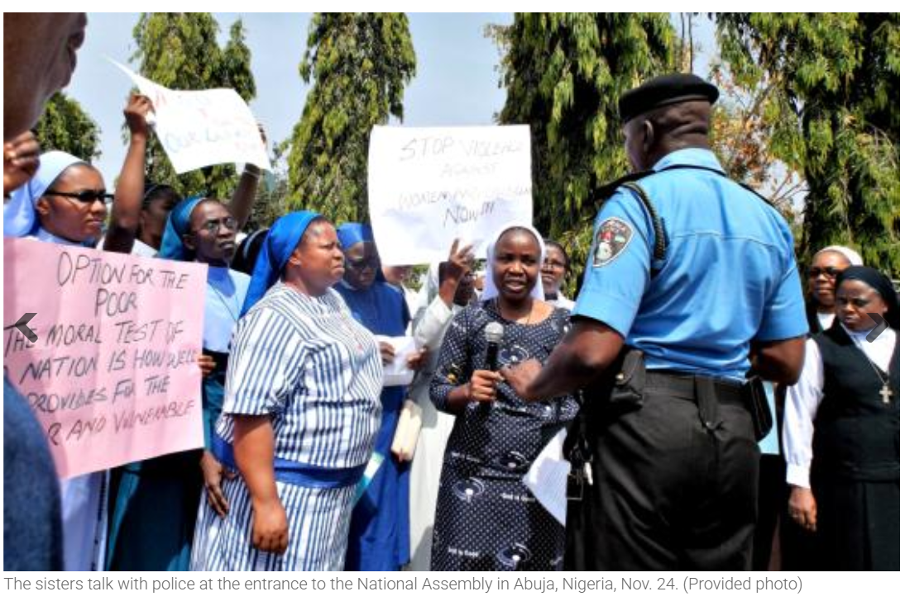
It's a vicious cycle. Poverty affects our mental health, and poor mental health makes it hard to escape poverty. We're a nation rich in resources, but poor in leadership and hope.

Slide 46
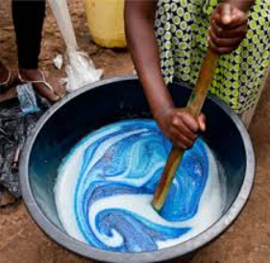
But even in the midst of this despair, I see glimmers of light. I think of my neighbour, Grace. She lost her job and her husband the same year. She had every reason to give up, but instead, she started a small business selling homemade soap. It's not much, but it keeps food on her table and her children in school.
Grace often tells me, "Blessing, we are not just coping, we are living by faith." Her words remind me of what the Bible says: "Those who are cast down will be lifted up." So, we keep moving, keep believing that one day, the storm will pass.
Source: The Analysis of A Soap Making Micro-Business in Nigeria

Slide 47
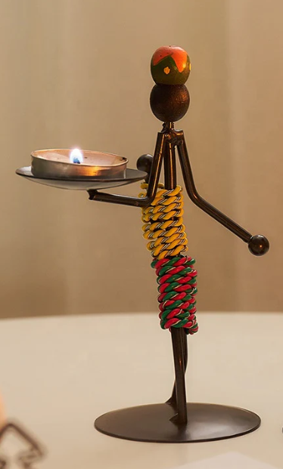
We keep trusting that God will open another door for us. We continue dreaming and working towards a better future. It's not easy, but we hold onto our faith. It pushes us towards the light at the end of the tunnel.
This is my testimony – that even in our struggles, we see evidence of God's faithfulness. We may be burdened, but we are not broken. We continue to work, to hope, to pray for the Nigeria we know is possible.
CANDLE LIGHTING by BLESSING
(Blessing lights a candle)
Blessing: The light at the end of the tunnel.
Source: The Mercantile Exchange

Slide 48
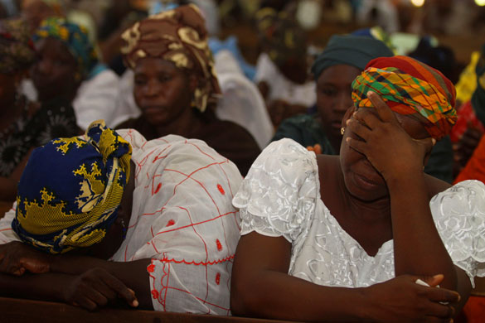
INTERCESSORY PRAYER
Leader 2: Let us pray:
Holy God, Giver of life and Sustainer of all, we give you thanks and praise for the persistence of Blessing, and all who keep moving forward despite even the most difficult circumstances. Continue to strengthen and comfort all who are weary from the burdens of life.
Source: Safe Nigeria Resources

Slide 49
Leader 2: God, you know the poverty plaguing many lands. Children go to bed hungry. Families struggle to meet basic needs. We remind you that you are Jehovah Jireh, the Great Provider, and we cry out for your provision. Open doors of opportunity and soften the hearts of those who can help.
We lift up all who live with mental health challenges, often compounded by poverty, stress, and the difficulties of daily life. When economic conditions worsen and the value of money diminishes, we see more of our sisters and brothers falling into despair. Comfort those contemplating suicide and show them that their lives have immeasurable value in your eyes.

Slide 50
Leader 2: We also pray with those facing other health issues. We especially remember the burden of malaria that still plagues our world, and we pray for better environmental management and healthcare to combat this persistent threat.
Jesus, you called us to come with all the burdens that weigh us down. Here we are! Lighten these loads and help us to cast our cares upon you.

Slide 51
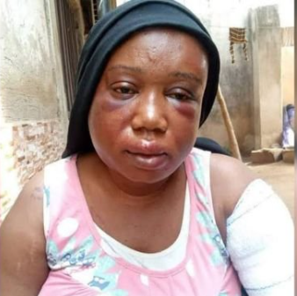
Leader 2: Holy Spirit, be our Comforter in times of distress. When we cannot see a way forward, be our guide.
Grant us the faith to keep moving forward even when the path seems impossible. Help us to be a light to others, sharing hope and extending a helping hand where we can.
We trust in your unfailing love and your promise that you will never leave us or forsake us.
Amen.
Source: Coalition for Women in Journalism

Slide 52
Leader 1: Please join me, now, in saying the Lord’s Prayer in your heart language.
⁹Our Creator, who is in heaven.
hallowed be your name.
¹⁰ Your kingdom come.
Your will be done,
on earth as it is in heaven.
¹¹ Give us this day our daily bread.
¹² And forgive us our debts,
as we also have forgiven our debtors.
¹³ And do not bring us to the time of trial,
but rescue us from the evil one.
For thine is the kingdom, and the power,
and the glory, forever. Amen.

Slide 53
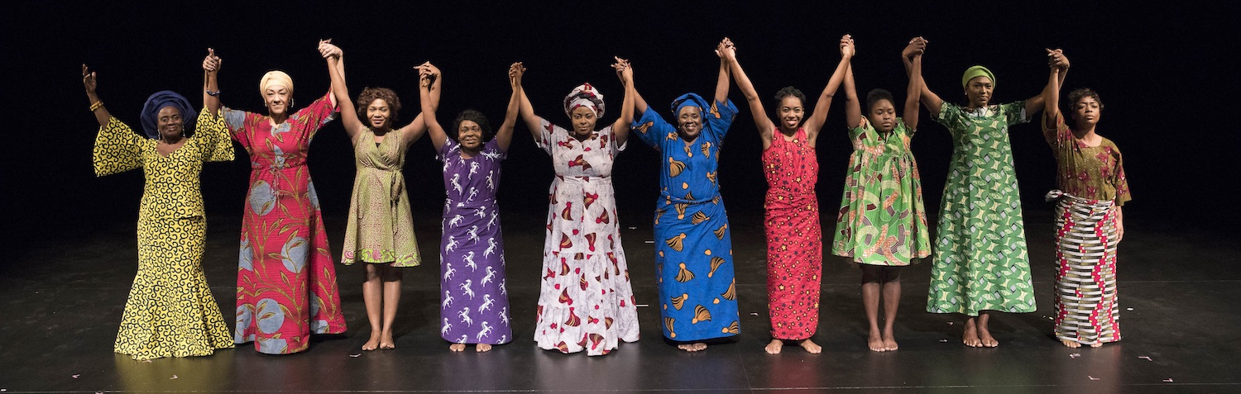
CALL TO ACTION
Leader 1: As we have journeyed through this service, we have become informed about the burdens carried by our sisters in Nigeria and around the world. We have prayed together, bringing these concerns before God, our great Burden Bearer.
Now, we come to a moment that calls us into prayerful action. The motto of World Day of Prayer is Informed Prayer, Prayerful Action, reminding us that our prayers should lead us to action for the transformation of the world.
Source: newyorktheatre.me

Slide 54
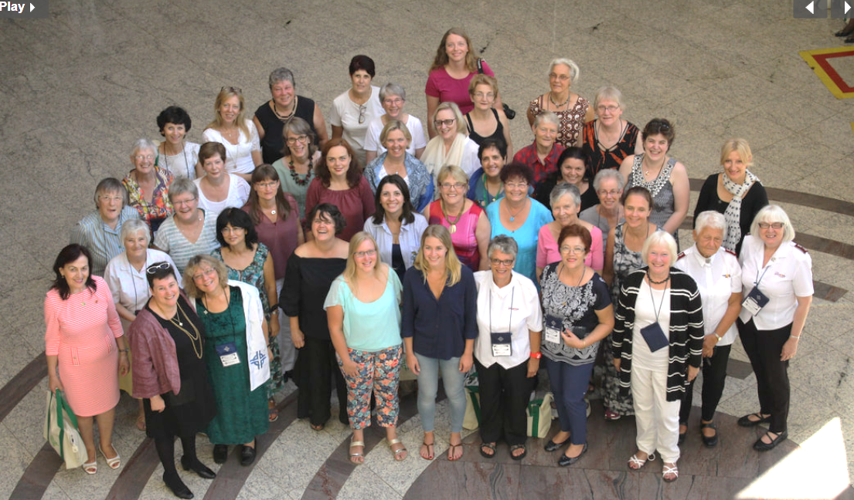
Leader 1: Let us respond to this call together, affirming our commitment to be Christ's hands and feet in a world longing for hope and rest.

Slide 55
Leader 1: Where do we find our hope in a burdened world?
All: In Christ, who bears all of our burdens.
Leader 1: How do we respond to overwhelming situations?
All: We remain resilient, believing that the storm will pass.
Leader 1: Where do we place our trust in uncertain times?
All: In God, the Giver of life and Sustainer of all.
Leader 1: What should we do when those around us are weary and heavily laden?
All: Bear one another’s burdens, as Christ bears ours.
Leader 1: As we go forth, what is our call to action?
All: To live out our informed prayers through prayerful action.
Leader 1: May we go forth with the strength of Christ.
All: We go with faith, hope, and love, to be light in the world.
Leader 1: Be a light in the world.

Slide 56
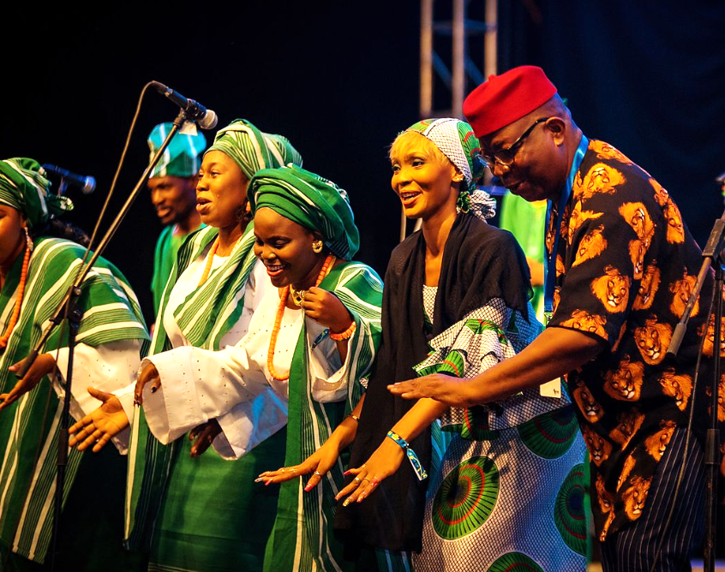
OFFERTORY
Leader 2:
Offering time is a blessed time! In Nigerian churches, it's customary for people to dance their offerings forward, expressing joy in giving and celebrating God's provision. This act of dancing reminds us that giving is not a burden, but a joyful response to God's grace. As we give today, let us bring our offerings with that same spirit of joy and thanksgiving.
Giving our financial resources is one way we can prayerfully act, through World Day of Prayer grants, so that all women and girls in Canada and throughout the world can live with dignity and respect.

Slide 57
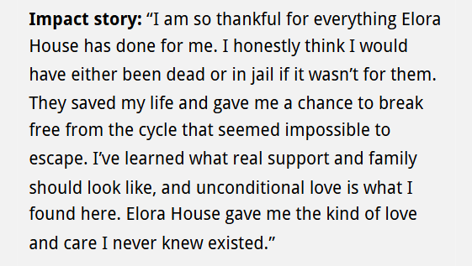
Leader 2: As well, your offering ensures the continuation of future World Day of Prayer services.
For a list of approved World Day of Prayer 2024-2025 grant projects, please go to wdpcanada.ca.
May we open our hearts and give generously as we are able. Whether you dance, walk, or remain seated as you give, let your offering be a symbol of your commitment to lighten the loads of others. May our gifts, like our prayers, be a tangible expression of God's love in the world.
As the offering is collected, we will be singing two verses of His Eye is on the Sparrow. (Or song of your choice)
Note: Cheques are payable to WICC or World Day of Prayer

Slide 58
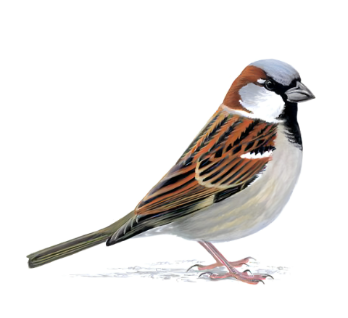
1. Why should I feel discouraged? Why should the shadows come?
Why should my heart be lonely, and long for heaven and home,
when Jesus is my portion? My constant friend is he:
His eye is on the sparrow, and I know he watches me;
his eye is on the sparrow, and I know he watches me.
Refrain:
I sing because I’m happy, I sing because I’m free,
for his eye is on the sparrow, and I know he watches me.
2. “Let not your heart be troubled,” his tender word I hear,
and resting on his goodness, I lose my doubts and fears;
though by the path he leadeth, but one step I may see:
His eye is on the sparrow, and I know he watches me;
his eye is on the sparrow, and I know he watches me.
Refrain
Source: House of Sparrow

Slide 59

Leader 2: We give thanks for these offerings and may God bless them.
Amen
CLOSING WORDS
Leader 1: As the melody of "His Eye is on the Sparrow" fades, we're reminded of God's tender care for each of us. Just as God watches over the sparrow, God sees our burdens - the weight of oppression, the pain of loss, the struggles with poverty and mental health. Through the stories we've heard, we've witnessed how God works in our lives, offering strength and hope even in the most difficult times.
Source: Freepik

Slide 60
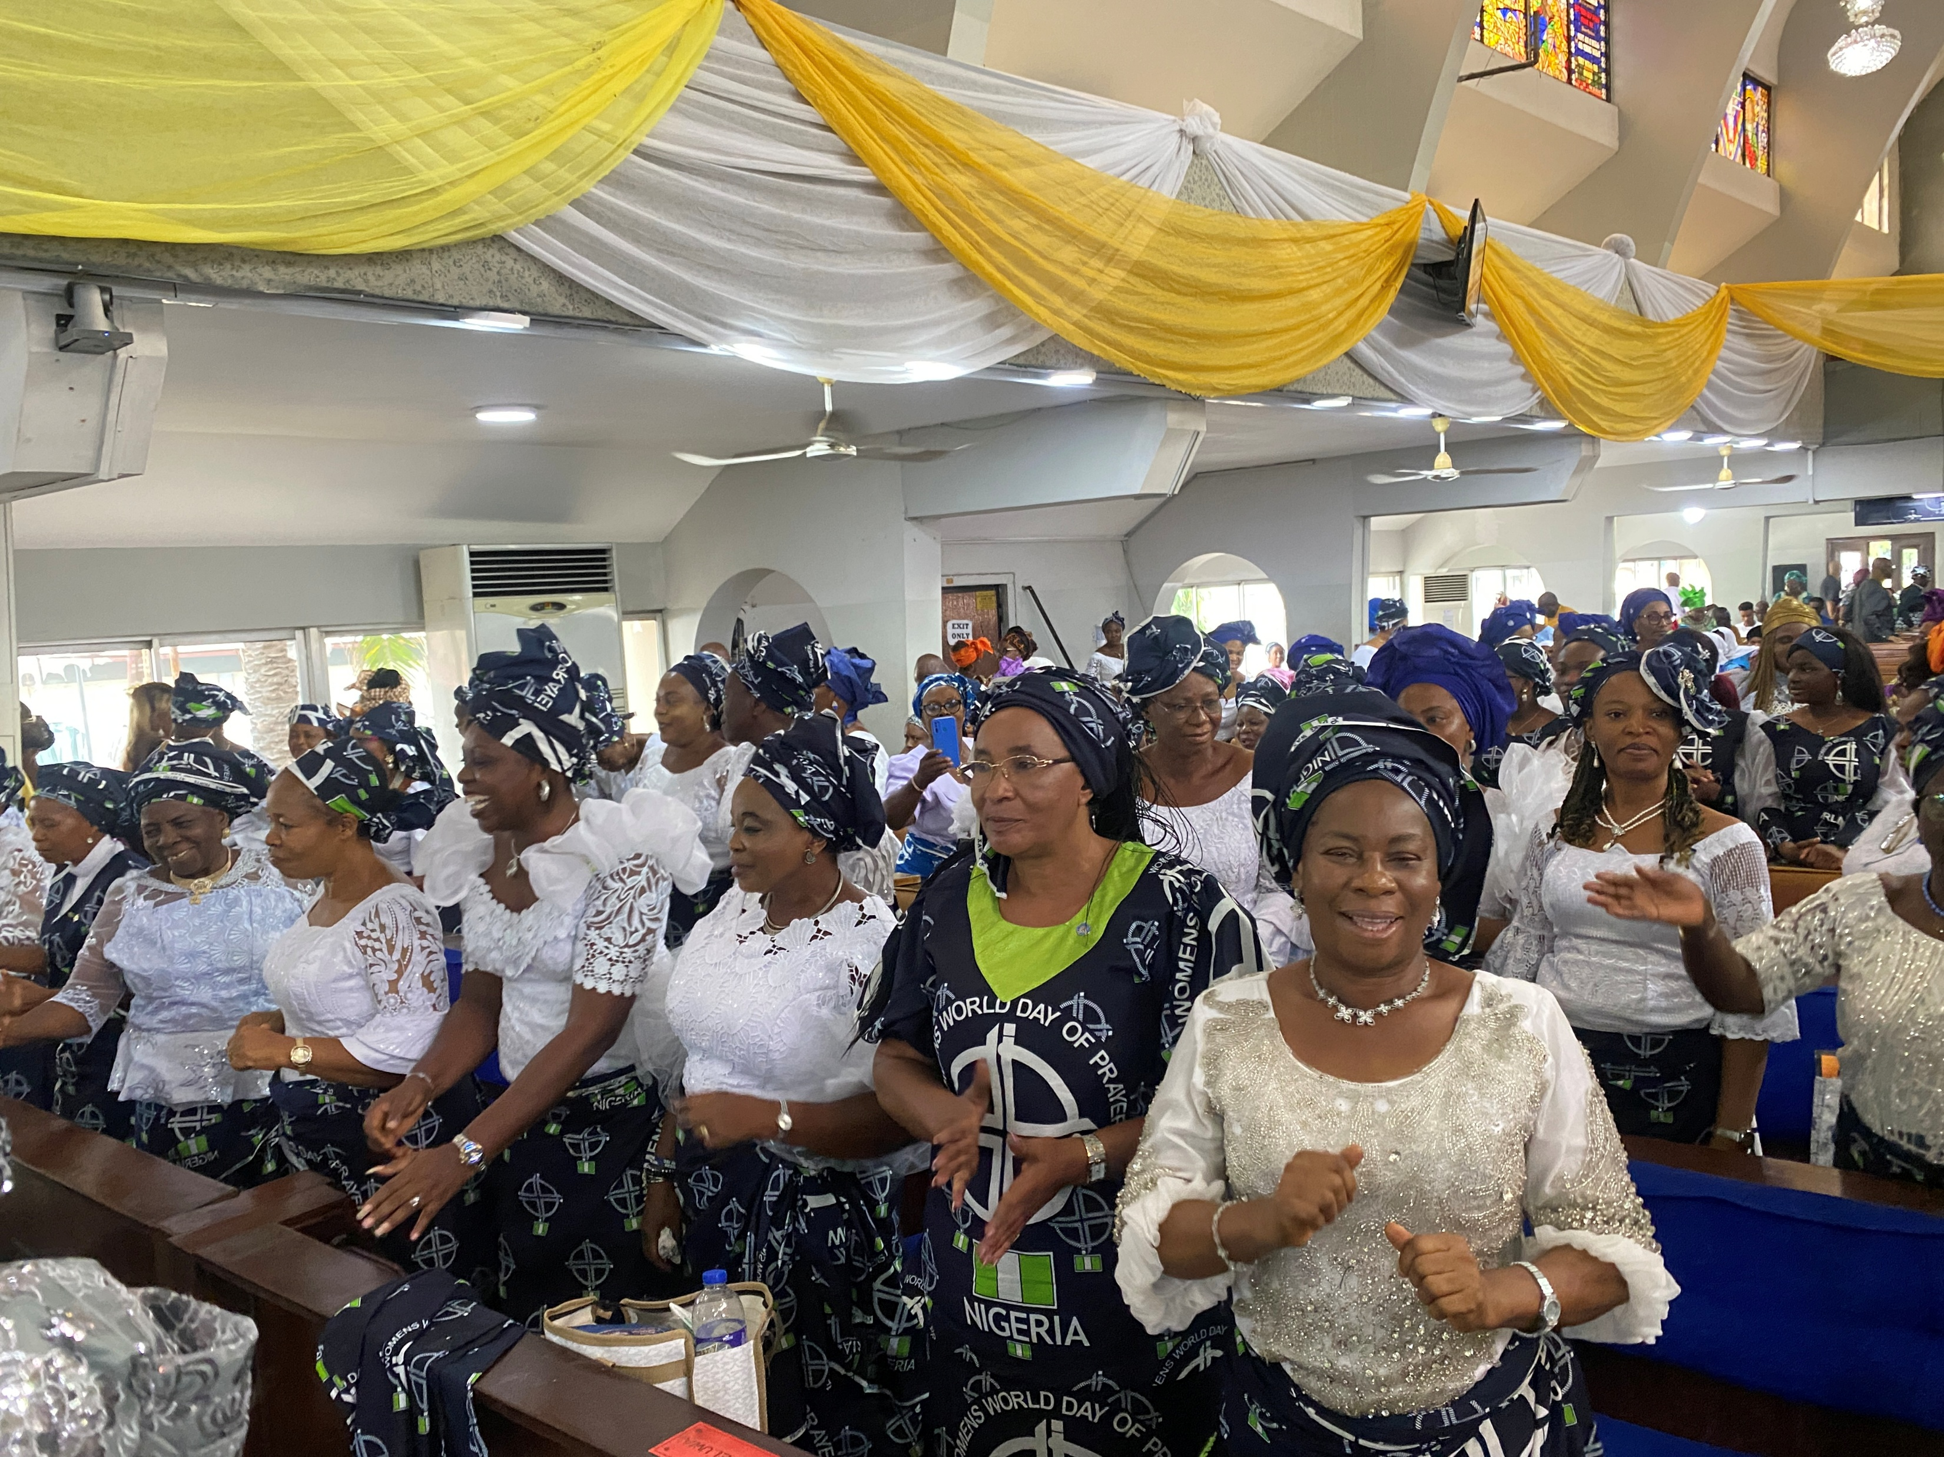
Leader 2: Today, we've seen God's hand at work in the lives of our Nigerian sisters. Through the community surrounding Beatrice, our widowed sister, God demonstrated how love can overcome systemic oppression. In Jato's story, we saw how God's strength sustains faith even in the face of persecution, challenging all of us to be instruments of peace and understanding. And through Blessing's testimony, God revealed how hope and resilience can flourish even amidst poverty and despair.

Slide 61
Leader 1: As we leave this place, let us remember that God invites us to be co-workers in lifting each other's burdens. God calls us to prayerful action - to be the friends who remind others of their worth, the community that supports the vulnerable, the voices that speak for the persecuted, and the hands that offer hope to the struggling. Let us collaborate with God in bringing comfort and justice to our world. As the body of Christ, we are empowered by Jesus' promise: "Come to me, all you who are weary and burdened, and I will give you rest." This assurance not only gives us peace but also propels us to action. May we go forth as living extensions of Christ, bringing God's rest and relief to all we encounter. In this way, we not only find our own rest in God but become channels of that divine rest for others.
Let us join together in singing, one last time, the refrain of the World Day of Prayer 2026 theme song “Come Unto Me.” (Or song of your choice)
Please stand as you are able.

Slide 62
COME UNTO ME
Refrain:
Come, come unto me, (2x)
Come, you who are weary, and I will give you rest.
Come, come unto me, (2x)
Come, you who are burdened, and I will give you rest.

Slide 63
Postlude
Copyright © 2024 World Day of Prayer International Committee, Inc.
“I Will Give You Rest: Come” was prepared by the World Day of Prayer Committee of Nigeria for the worship service and educational activities for the 2026 World Day of Prayer (WDP) annual celebration. WDP materials are developed for the exclusive use of WDP programs organized by national or local committees and their partner organizations. For any other use, materials from the WDP 2026 Resource Packet may not be reproduced without the permission of World Day of Prayer International Committee (WDPIC).
Limited reproduction rights granted—Bible study, Worship Service, Country Background, Children’s Program, Artwork and Artist Statement, WDP composed songs and photos may be reproduced—printed or electronically—for WDP activities with congregations and groups, if appropriate credit is given. WDP National/Regional Committees are permitted to resell reproductions of the resources for the purposes of the WDP program.

Slide 64
Only WDP National Committees connected with WDPIC can make the resource packet or sections of the materials available online. Committees that make materials available online must ensure groups and individuals who access the online materials are accountable to the committee.
The songs suggested for the worship service and children’s program include copyrighted information from the publishers. Permission to reproduce or translate the songs must be obtained from the publishers. WDPIC only gives permission to reproduce or translate the songs that are originally composed for WDP programs.
Scripture quotations are from the New Revised Standard Version of the Bible, copyright © 1989 by the Division of Christian Education of the National Council of Churches of Christ in the U.S.A. and are used by permission. All rights reserved.
Any offerings or funds collected related to WDP activities must be reported to the Women’s Inter-Church Council of Canada. Please make cheques payable to WICC or World Day of Prayer.

Slide 65
For further information, please contact:
Women’s Inter-Church Council of Canada.
47 Queen’s Park Cres East
Toronto, ON M5S 2C3 Email: wicc@wicc.org website: wdpcanada.ca phone: 416.929.5184
Frequently Asked Questions:
1. Who is writing the 2027 World Day of Prayer service? The World Day of Prayer International Committee - ​"United in Prayer for Justice and Peace!" in celebration of the WDP 100th anniversary.
2. Are you seeking funding for a social justice project in your community? WICC distributes WDP grants up to $5,000. The application deadline is March 31, 2026. Go to wdpcanada.ca for details.
3. How can I become a WICC board member? Go to https://wicc.org/get-involved/volunteer-opportunities/

Slide 66
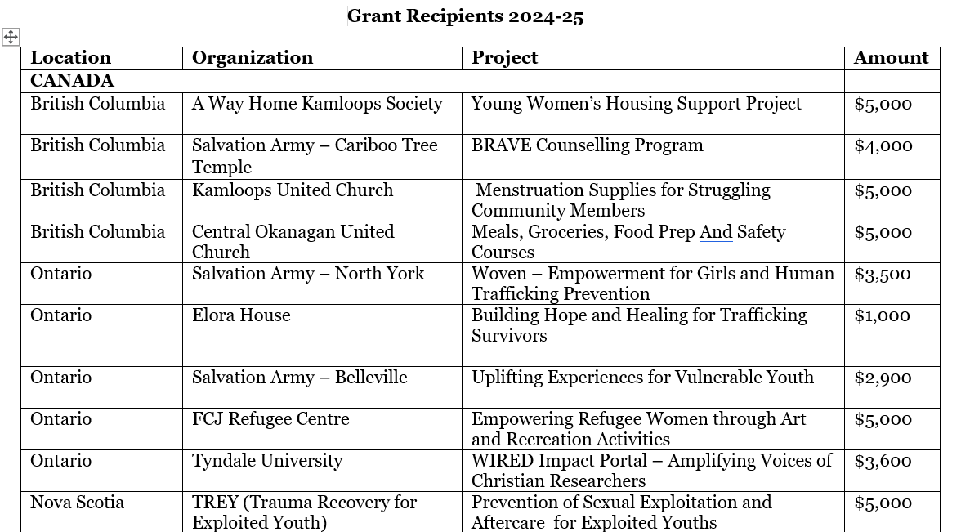

Slide 67
