Slide 1
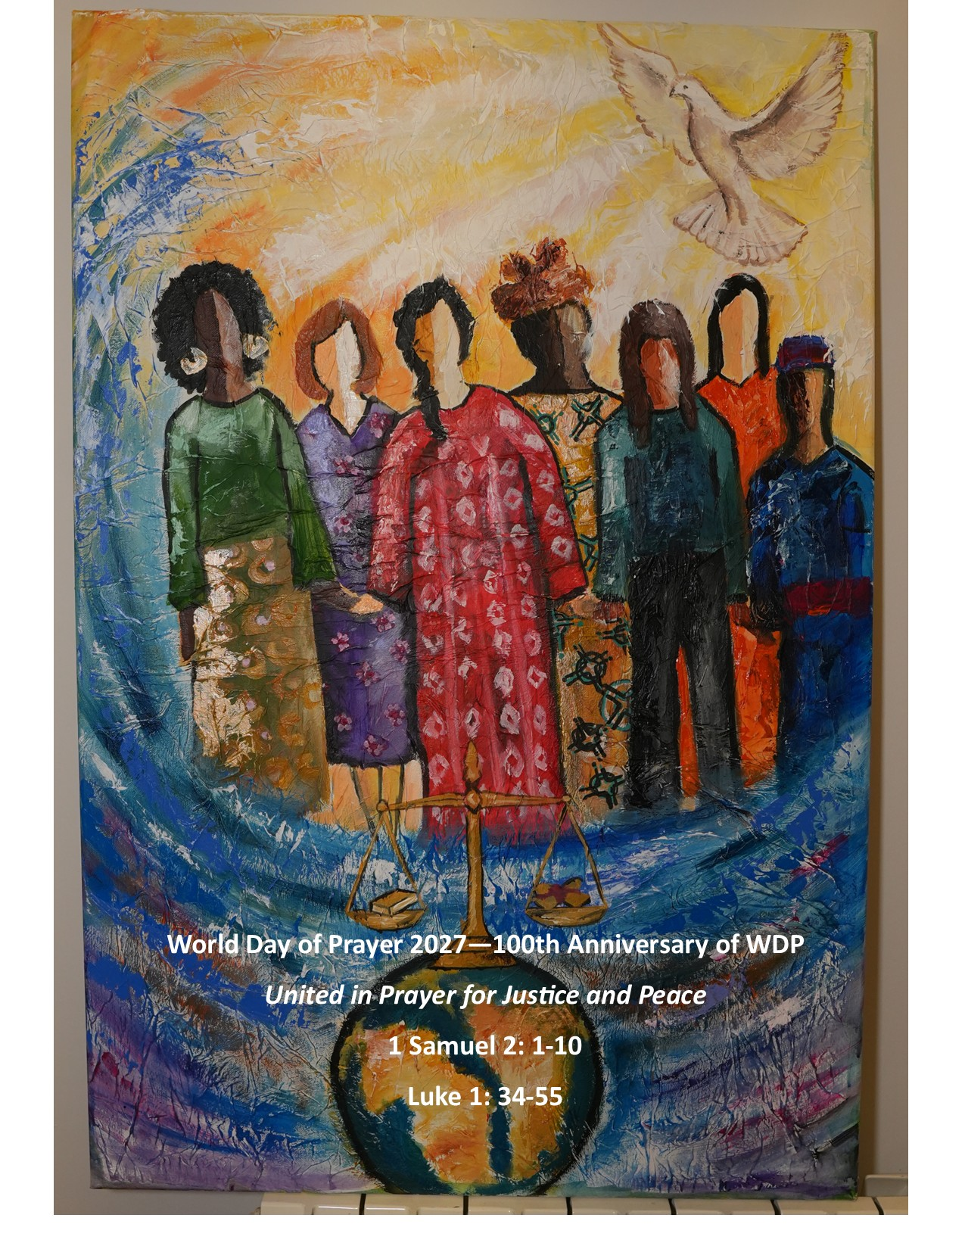
World Day of Prayer 2027 – 100th Anniversary
World Day of Prayer 2027 is an ecumenical service written by the World Day of Prayer International Committee for the 100th anniversary of this prayer event! This is a wonderful opportunity to pray, learn about the history of World Day of Prayer, sing and be in fellowship with others. All are welcome to attend. Donations will support social justice grants distributed in Canada and around the world.
Theme: United in Prayer for Justice and Peace
Scripture Base: 1 Samuel 2: 1-10 & Luke 1: 39-55
Location:
Date:
Time
For more information, contact:

